Slide 1

A Brief Introduction to Behavioral Economics
Josh Martin
Guest Lecture for MK 351
1/27/2025

Slide 2
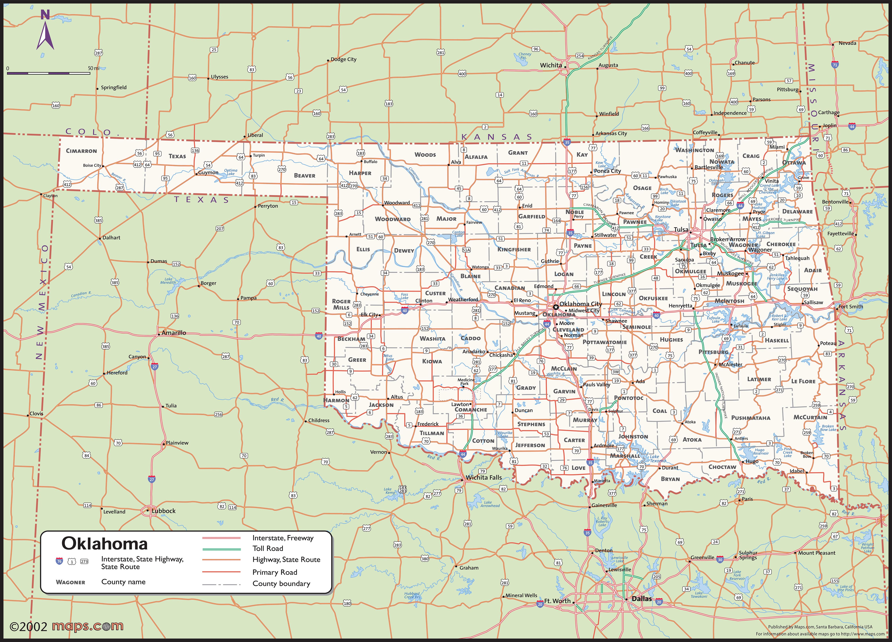
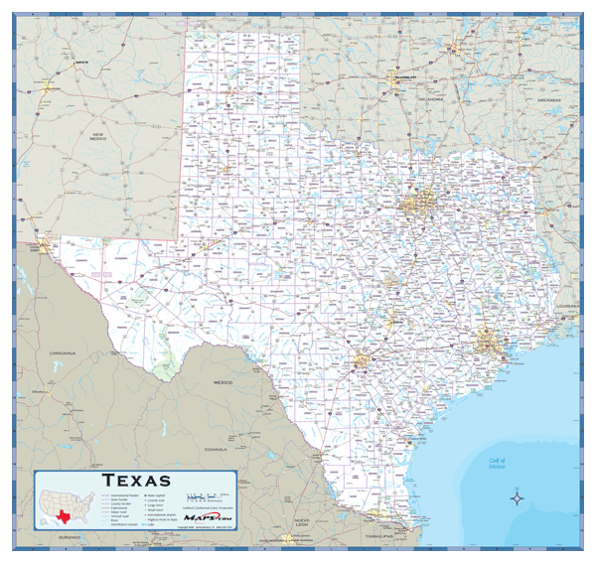
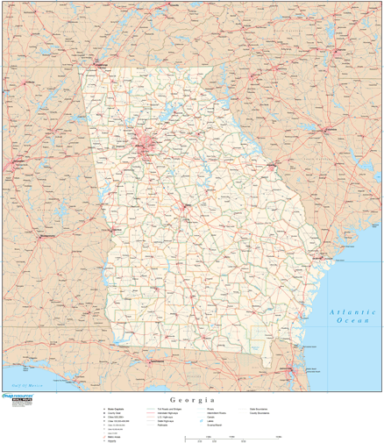
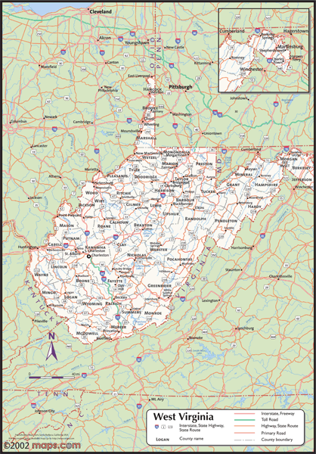
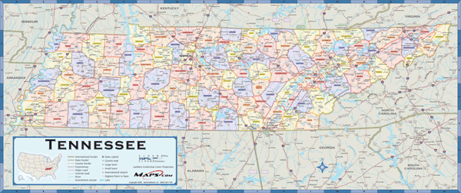


Slide 3
Introduction and Context
Definition: Behavioral Economics integrates psychology with economic theory to explain decision-making, focusing primarily on the limitations of “rationality” in economic decision-making.
Why It Matters for Marketers: Understanding cognitive biases and heuristics helps in crafting more effective campaigns.
Today’s Focus: Key thinkers (Kahneman, Tversky, Thaler), seminal works (Thinking, Fast and Slow, Nudge), key concepts (Heuristics, Prospect Theory, Loss Aversion) and recent controversies.

Slide 4
Traditional Economics vs. Behavioral Economics
Rational Actor Model:
Consistency: Preferences are stable and logically ordered (e.g., if someone prefers A over B and B over C, they should also prefer A over C).
Optimization: Individuals choose the best possible option from the available alternatives to achieve their goals, often modeled as utility maximization.
Behavioral Twist: People are “predictably irrational,” influenced by biases, emotions, and social context.

Slide 5
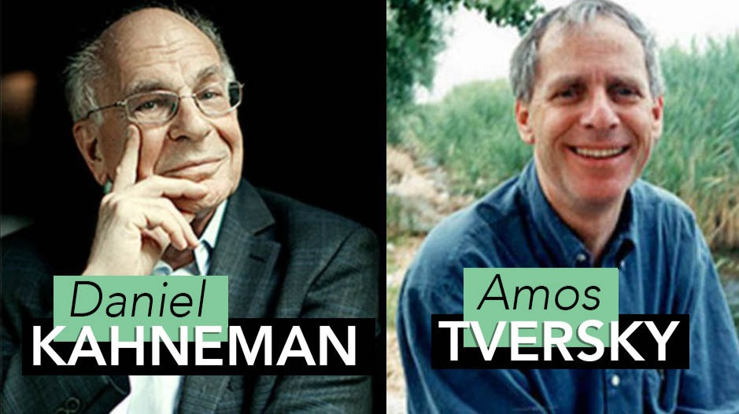
Kahneman & Tversky – Pioneers of Behavioral Economics
Key Contributions: Developed Prospect Theory, foundational to understanding how people handle risk and uncertainty.
Prospect Theory: Demonstrates that the way choices are framed affects decisions more than the pure economic outcome.
Background: Both were psychologists exploring how cognitive biases systematically affect economic decisions.

Slide 6
Kahneman & Tversky – Pioneers of Behavioral Economics
Once Controversial: Challenged the once-dominant assumption that humans are perfectly rational—this shook the core of economic theory.
Legacy: Their research paved the way for a wave of interdisciplinary studies, leading to a Nobel Prize (Kahneman in 2002; Tversky dies in in 1996).

Slide 7
Classical Economic Theory
Paradox of Value: Despite water being essential for life and diamonds being largely nonessential, diamonds command a higher price in the market.
Different Types of Value: Water has high use value (vital for survival), while diamonds have high exchange value (scarcity and desirability drive up price).
Utility and Marginal Utility: In utility theory, a good’s marginal utility (the additional satisfaction from consuming one more unit) influences its perceived value—because water is abundant, its marginal utility (and thus price) can be lower.
Diminishing marginal utility: as a person consumes more of a good, the additional satisfaction (utility) gained from each extra unit decreases.

Slide 8
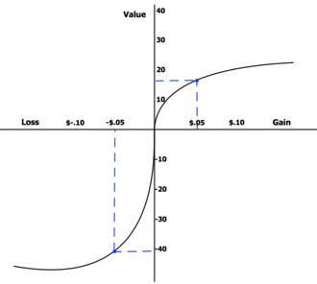
Prospect Theory & Loss Aversion
Loss Aversion: Individuals experience losses more intensely than gains of the same magnitude
People derive their utility from "gains" and "losses" relative to a specific reference point, which varies depending on their unique circumstances
Rather than behaving as "rational" agents (e.g., using expected utility theory to select the option with the highest value), decisions are made based on relative comparisons rather than absolute values

Slide 9
Loss Aversion Example
Deal or No Deal?
Option A: Receive $40
Option B: 50% chance to win $200 and a 50% chance to lose $100
Loss Aversion: Even though the gamble has a higher expected payoff, many opt for the sure gain to avoid the potential loss.
Proportional (and even 1.5:1) increases in the ratio of payoffs to loss in option B decrease the odds it is selected.
Key Insight: For many, the pain of a possible loss outweighs the pleasure of a larger expected gain.

Slide 10
Endowment Effect Example
Coffee Mug or Ballpoint Pen?
Cornell University undergraduates were given a coffee mug
Then offered the chance to sell it or trade it for an equally valued alternative
Finding: Once their ownership of the mug had been established, participants’ required compensation for the mug was approximately twice as high as the amount they were willing to pay to acquire the mug

Slide 11
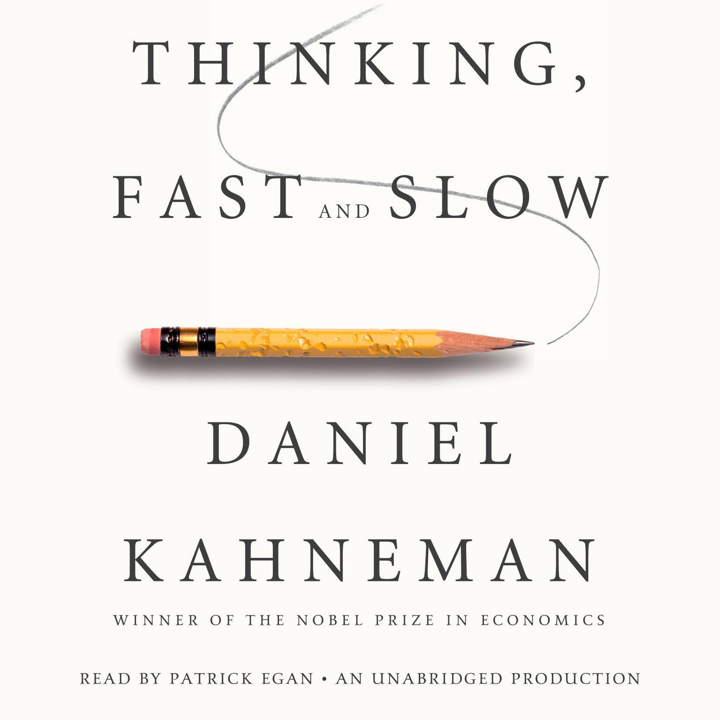
Thinking, Fast and Slow
Two Systems:
System 1: Fast, automatic, intuitive thinking (i.e. heuristics)
System 2: Slower, more deliberate, analytical thought
Relevance to Marketers: Most brand perceptions and consumer decisions arise from System 1’s quick, emotional judgments.
Common Biases: Anchoring, availability heuristic, and overconfidence.

Slide 12
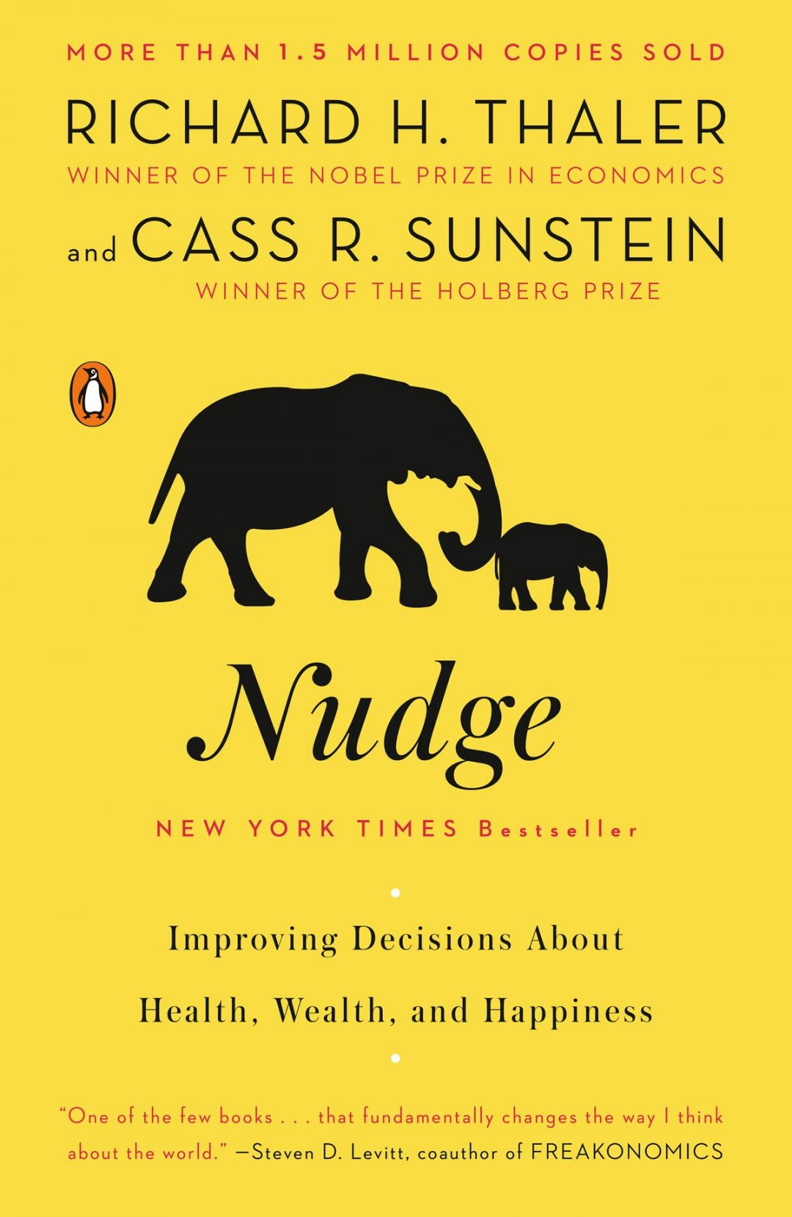
Richard Thaler & “Nudge”
Behavioral Economics in Policy: Nudge theory focuses on designing choices to guide (not force) better decisions (e.g., organ donation opt-out).
Key Idea: Small interventions in choice architecture can lead to significant changes in behavior.
Global Influence: Governments worldwide adopted “nudge units” to shape public policy (health, finance, environment).
Ethical Considerations: Distinction between helpful guidance vs. manipulation.
Academic Recognition: Thaler awarded the Nobel Prize in Economics (2017) for his contributions to Behavioral Economics.

Slide 13
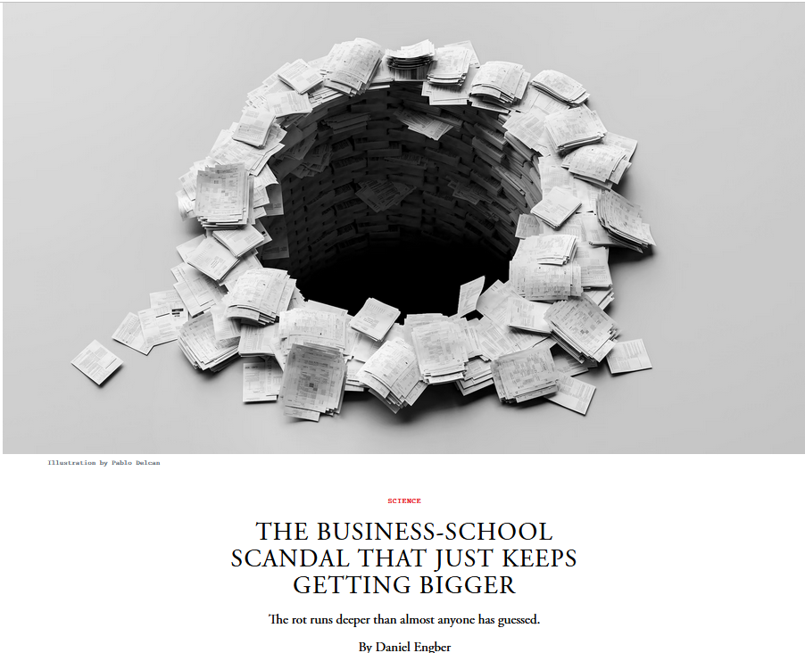
Dan Ariely, Francesca Gino, and the Recent Controversies
Background: Dan Ariely (author of Predictably Irrational) and Francesca Gino are prominent behavioral scientists.
The Scandal: Allegations of data fabrication or manipulation in key studies, casting doubt on some published findings.
Implications: Underscores the importance of research transparency and replication in behavioral science.
Media Spotlight: Sparked debates on peer review standards, the pressure to publish groundbreaking results, and public trust in science.

